Slide 1
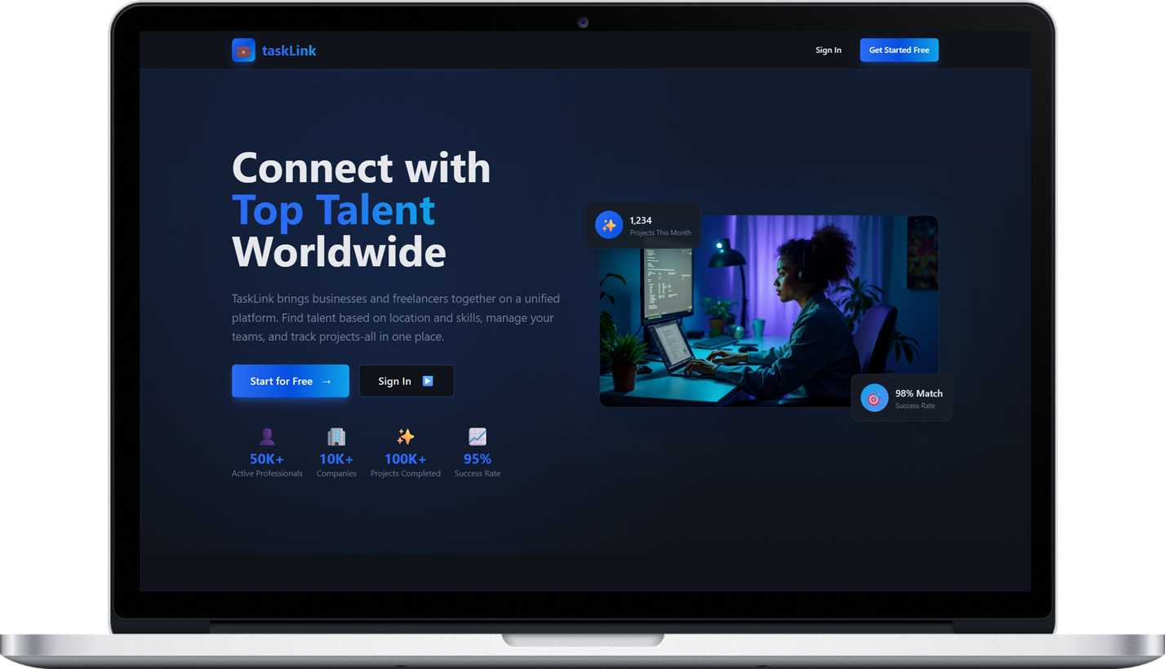

taskLink
Connecting Talent with Opportunity.
Brought to you by GitHappens

Slide 2

taskLink
ABOUT US
The Problem
We are aiming to solve
Many job seekers struggle to find contract or local positions,
while around 68% of EU SMEs report skills shortages in their workforce.
Our app tackles these inefficiencies by connecting talent with employers quickly,
making contract hiring and job search faster, simpler, and more effective.

Slide 3






Find talented freelancers in your area or anywhere in the world. Filter by location, timezone, and availability.
taskLink
ABOUT US
How the App Makes Finding a job and hiring employees easier
The app helps job seekers find nearby opportunities quickly and build AI-enhanced CVs. Employers can post jobs, manage applicants, and organize teams easily. It makes hiring and job searching faster, simpler, and more efficient.

Slide 4
Find talented freelancers in your area or anywhere in the world. Filter by location, timezone, and availability.

Slide 5
Find talented freelancers in your area or anywhere in the world. Filter by location, timezone, and availability.
Search for professionals with specific skills and expertise. Filter by experience level, ratings, and past work.
taskLink
ABOUT US
How the App Makes Finding a job and hiring employees
The app helps job seekers find nearby opportunities quickly and build AI-enhanced CVs. Employers can post jobs, manage applicants, and organize teams easily. It makes hiring and job searching faster, simpler, and more efficient.

Slide 6
Search for professionals with specific skills and expertise. Filter by experience level, ratings, and past work.

Slide 7
Search for professionals with specific skills and expertise. Filter by experience level, ratings, and past work.
Build and manage your teams with ease. Assign roles, track progress, and collaborate in real-time.
taskLink
ABOUT US
How the App Makes Finding a job and hiring employees
CIACAn
The app helps job seekers find nearby opportunities quickly and build AI-enhanced CVs. Employers can post jobs, manage applicants, and organize teams easily. It makes hiring and job searching faster, simpler, and more efficient.

Slide 8
Build and manage your teams with ease. Assign roles, track progress, and collaborate in real-time.

Slide 9
Build and manage your teams with ease. Assign roles, track progress, and collaborate in real-time.
Connect with professionals, share updates, and build your network. Engage with the community.
taskLink
ABOUT US
How the App Makes Finding a job and hiring employees
The app helps job seekers find nearby opportunities quickly and build AI-enhanced CVs. Employers can post jobs, manage applicants, and organize teams easily. It makes hiring and job searching faster, simpler, and more efficient.

Slide 10
Connect with professionals, share updates, and build your network. Engage with the community.

Slide 11
Connect with professionals, share updates, and build your network. Engage with the community.
Create, assign, and track tasks effortlessly. Set deadlines, priorities, and monitor project progress.
taskLink
ABOUT US
How the App Makes Finding a job and hiring employees
The app helps job seekers find nearby opportunities quickly and build AI-enhanced CVs. Employers can post jobs, manage applicants, and organize teams easily. It makes hiring and job searching faster, simpler, and more efficient.

Slide 12
Create, assign, and track tasks effortlessly. Set deadlines, priorities, and monitor project progress.

Slide 13
Create, assign, and track tasks effortlessly. Set deadlines, priorities, and monitor project progress.
Post jobs or find opportunities. Streamlined hiring process with built-in communication tools.
taskLink
ABOUT US
How the App Makes Finding a job and hiring employees
The app helps job seekers find nearby opportunities quickly and build AI-enhanced CVs. Employers can post jobs, manage applicants, and organize teams easily. It makes hiring and job searching faster, simpler, and more efficient.

Slide 14
Post jobs or find opportunities. Streamlined hiring process with built-in communication tools.

Slide 15
Post jobs or find opportunities. Streamlined hiring process with built-in communication tools.
taskLink
ABOUT US
How the App Makes Finding a job and hiring employees
The app helps job seekers find nearby opportunities quickly and build AI-enhanced CVs. Employers can post jobs, manage applicants, and organize teams easily. It makes hiring and job searching faster, simpler, and more efficient.

Slide 16

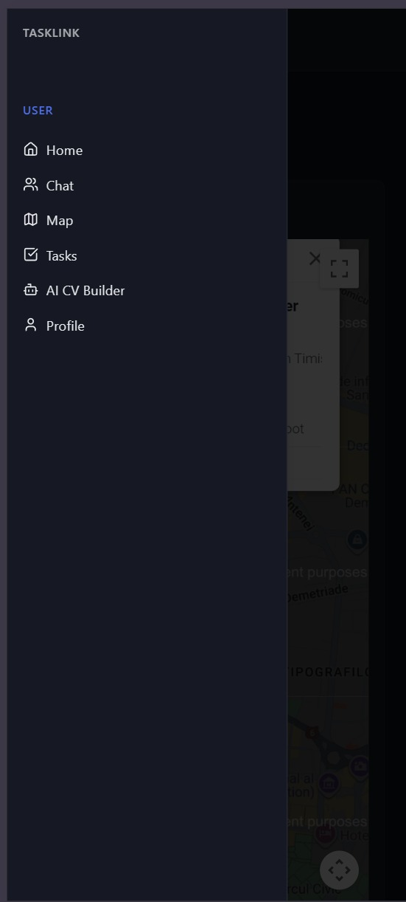
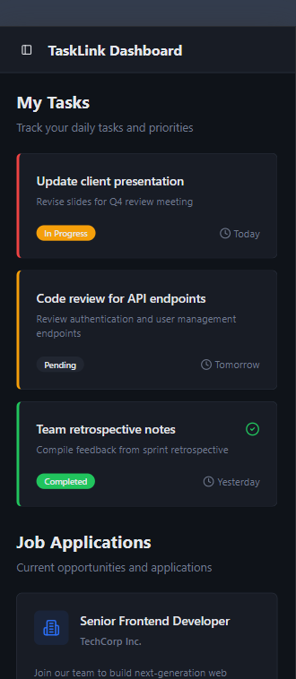
taskLink
User Interface
User Home Page
The user home page gives a clear, organized view of all assigned tasks, making it easy to track progress and stay focused. It is a streamlined space designed to help users stay efficient and in control.

Slide 17
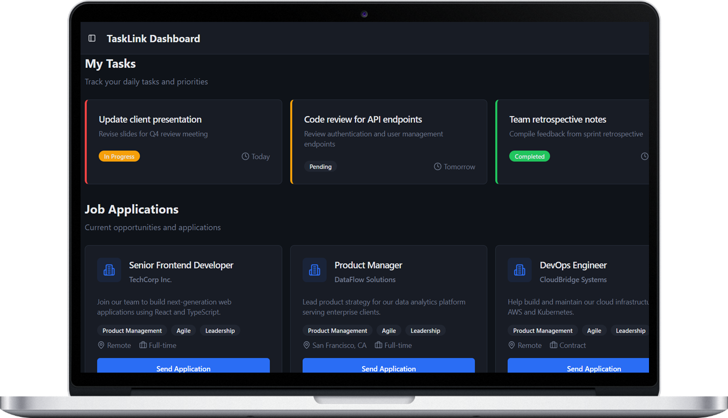
User Home Page
The user home page gives a clear, organized view of all assigned tasks, making it easy to track progress and stay focused. It is a streamlined space designed to help users stay efficient and in control.
User Chat & Teams
Built-in messaging lets users communicate instantly with their employer and assigned team keeping coordination simple and fast. It is a straightforward, organized space for updates, questions and seamless work.

Slide 18
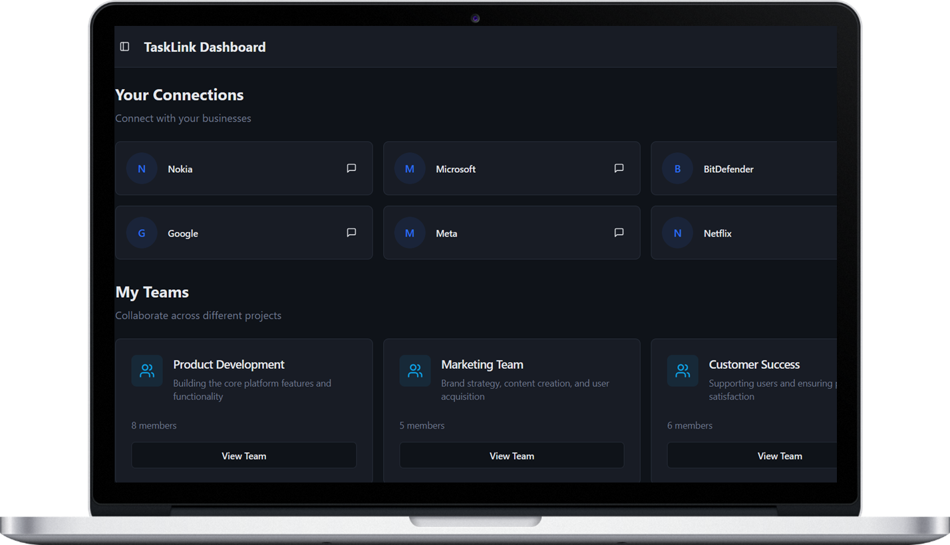
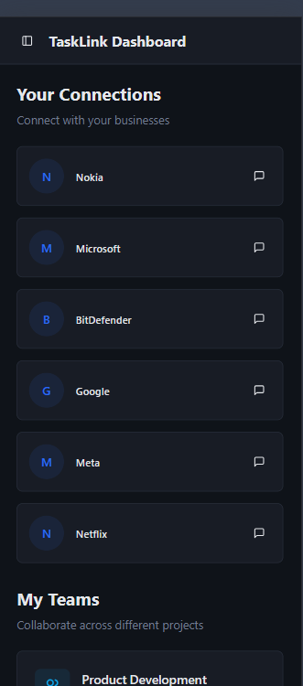
User Chat & Teams
Built-in messaging lets users communicate instantly with their employer and assigned team keeping coordination simple and fast. It is a straightforward, organized space for updates, questions and seamless work.
User Home Page
The user home page gives a clear, organized view of all assigned tasks, making it easy to track progress and stay focused. It is a streamlined space designed to help users stay efficient and in control.
User Map
The interactive map lets users quickly find companies that are actvely hiring. With a clear, intuitive view of their surroundings, discovering local opportunities becomes faster, easier, and far more convenient.

Slide 19


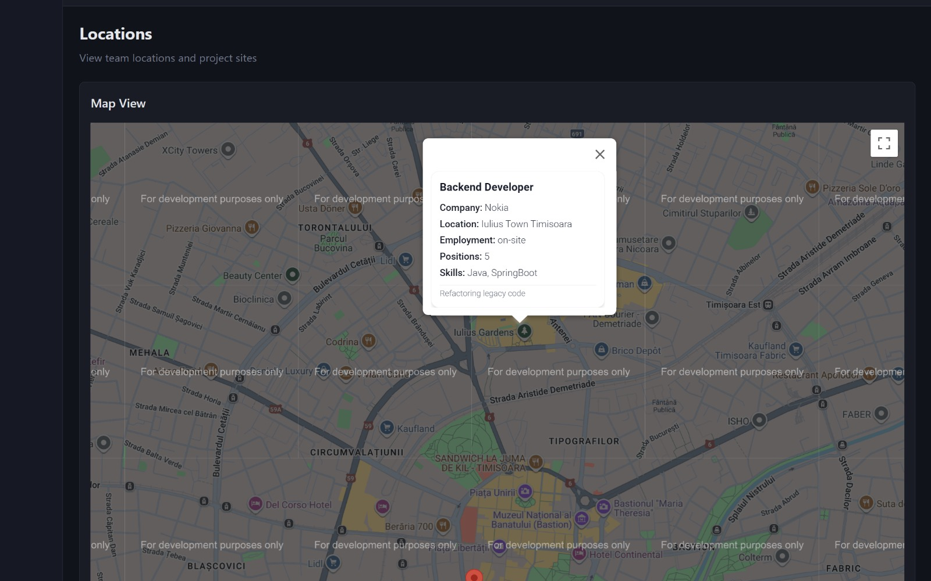
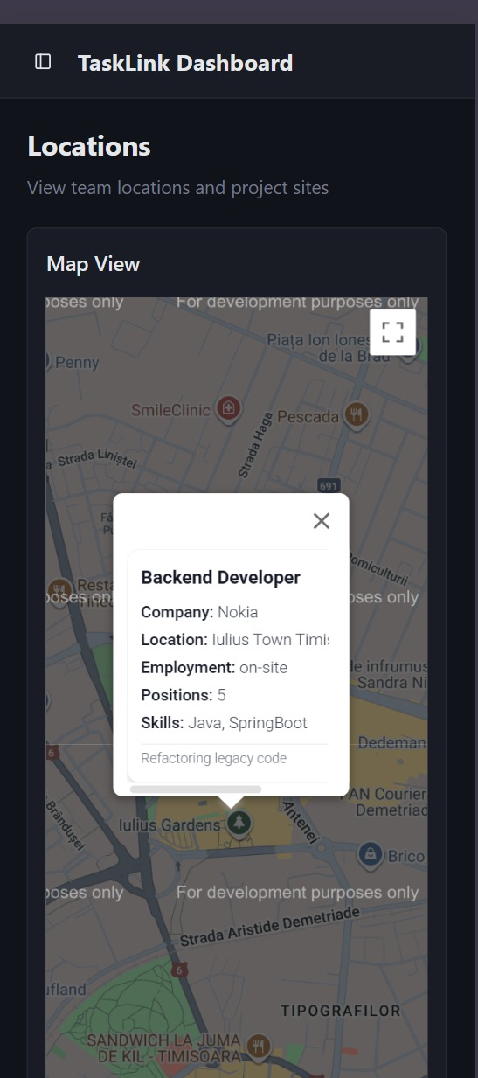
User Map
The interactive map lets users quickly find companies that are actvely hiring. With a clear, intuitive view of their surroundings, discovering local opportunities becomes faster, easier, and far more convenient.
User Chat & Teams
Built-in messaging lets users communicate instantly with their employer and assigned team keeping coordination simple and fast. It is a straightforward, organized space for updates, questions and seamless work.

Slide 20

Advanced tools for ambitious careers.

Slide 21
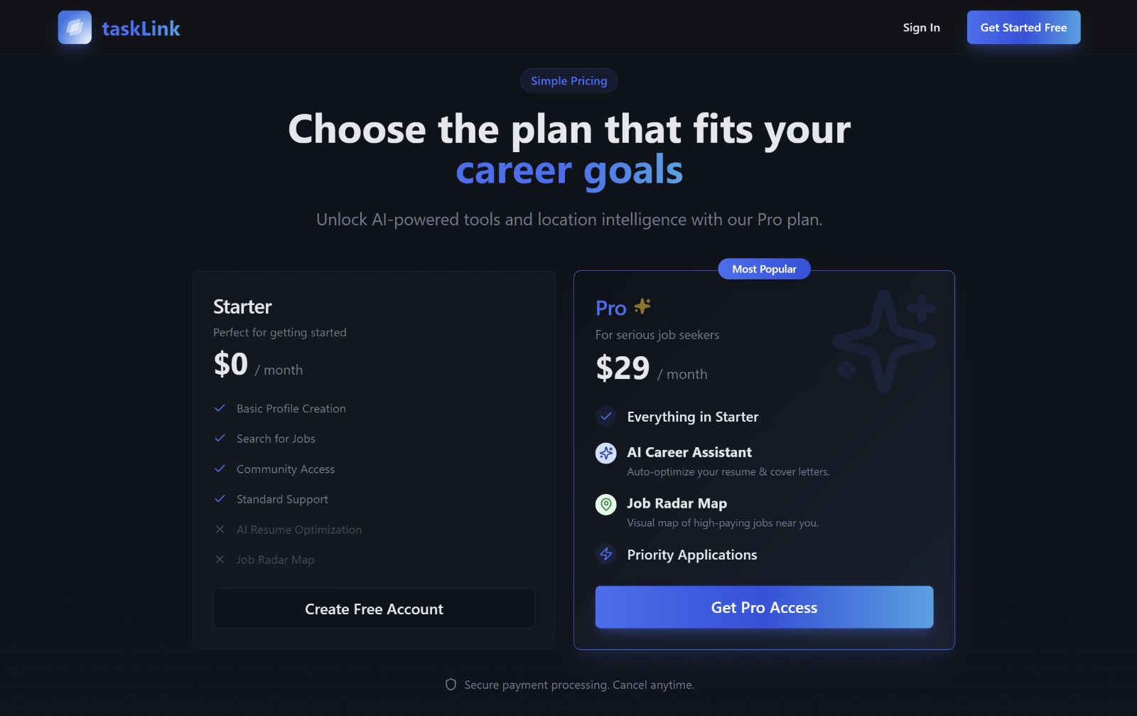
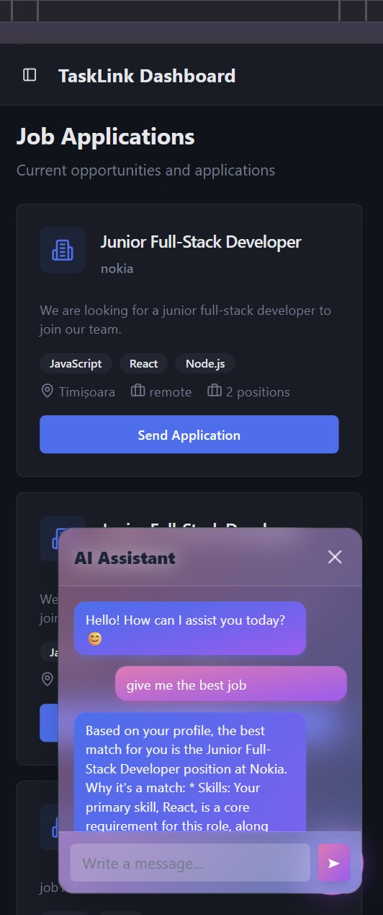
taskLink
Premium Plan
The Premium plan unlocks everything the starter plan provides, adding an interactive job-map and an AI assistant that recommends the most relevant job opportunities, giving users smarter, more personalized guidance.

Slide 22
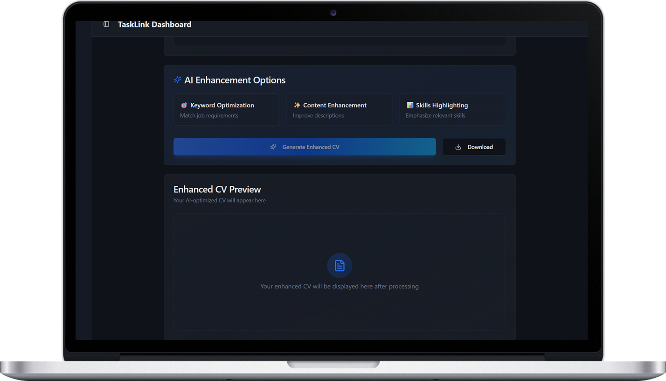
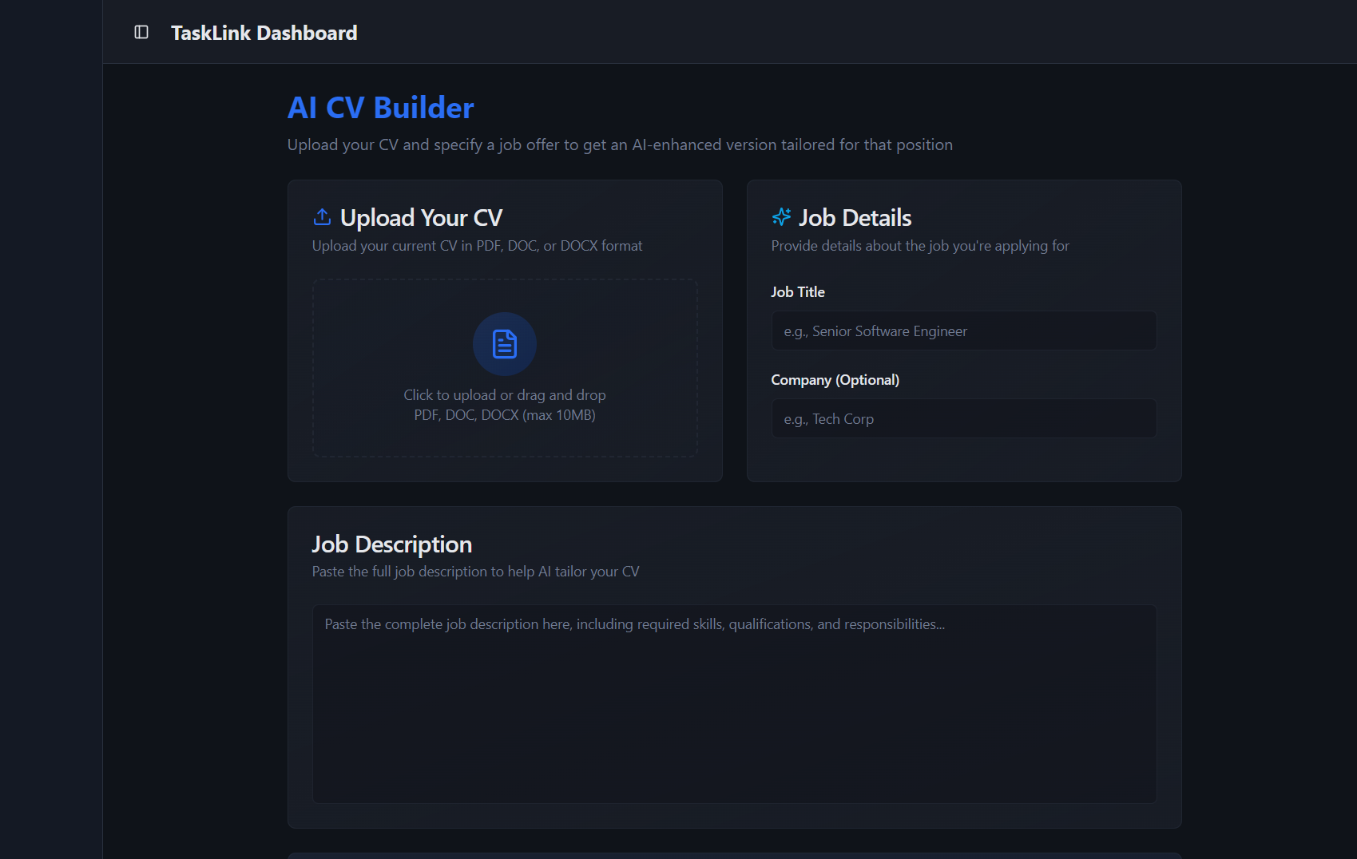
taskLink
ABOUT US
Premium Features

Slide 23
taskLink
User AI CV Builder
The CV AI builder aids users in forging custom resumes, leveraging uploaded documents and position-specific details to present their experience with precision and impact.

Slide 24
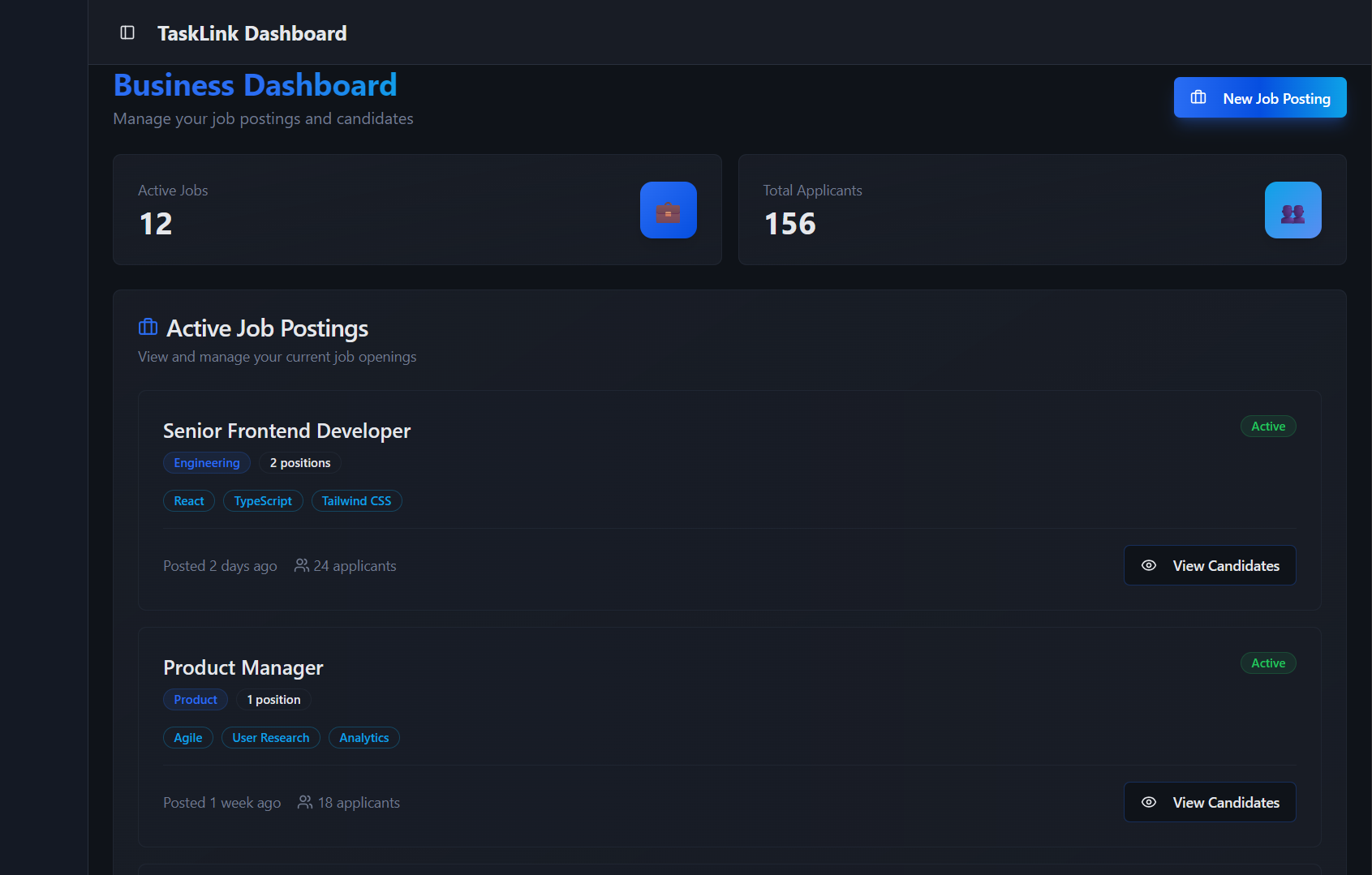
taskLink
Business Home Page
The business home page delivers an intelligible overview of all ongoing listings, allowing employers to asses their recruitment landscape instantly. Its uncluttered design makes overseeing vacancies both effortless and highly effective.
Business Interface

Slide 25
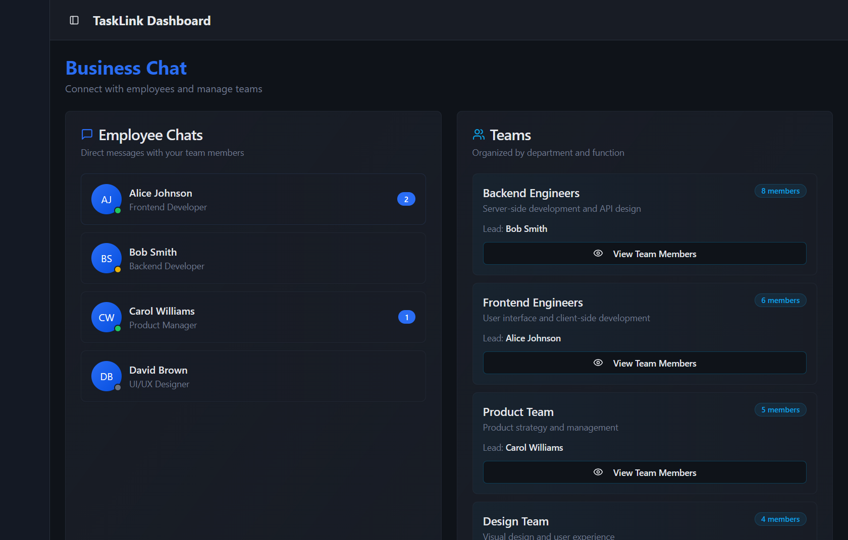
taskLink
Business Home Page
The business home page delivers an intelligible overview of all ongoing listings, allowing employers to asses their recruitment landscape instantly. Its uncluttered design makes overseeing vacancies both effortless and highly effective.
Business Chat & Teams
The platform enables businesses to create structured teams composed of employess and maintain consistent communication through integrated chat. Employers can reach individuals and groups instantly, ensuring coordination remains clear and efficient, within a single workspace.
Business Interface

Slide 26
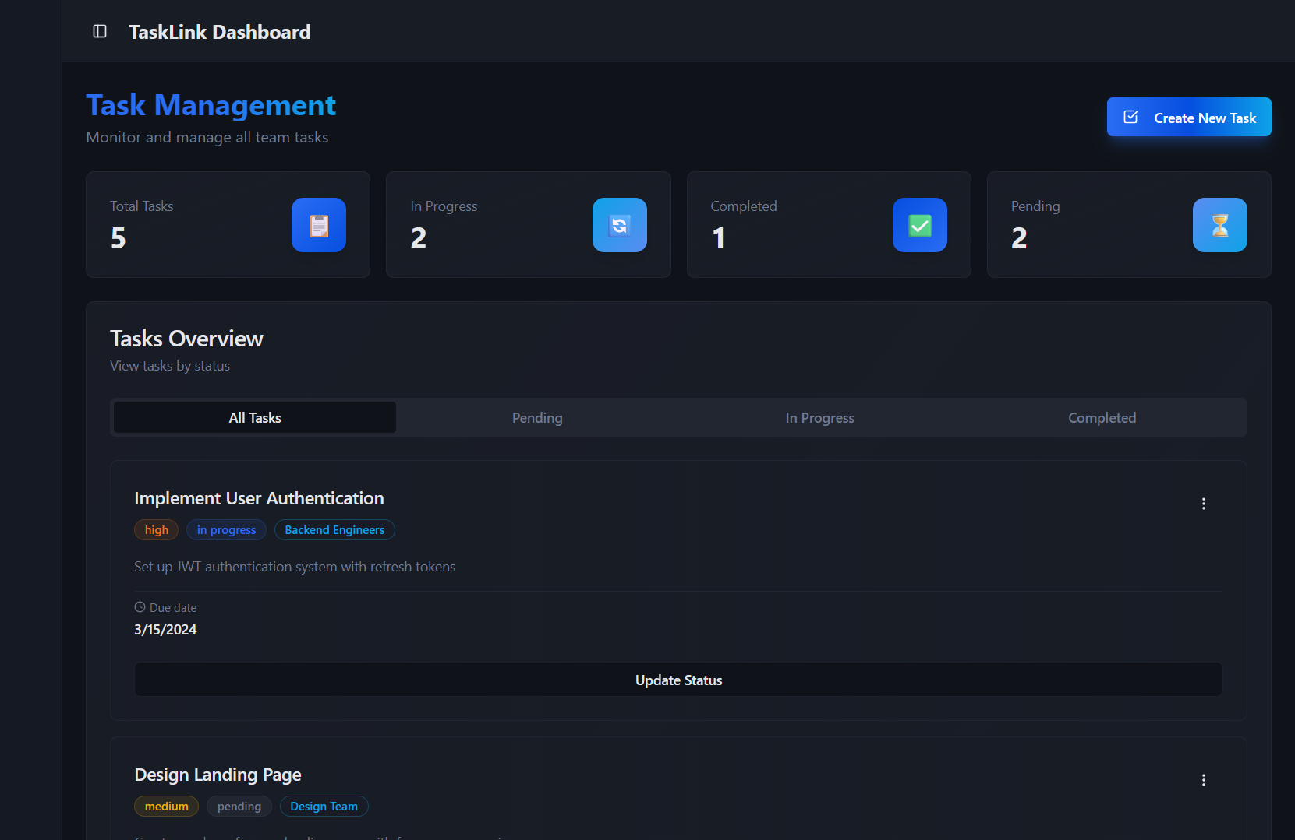
taskLink
Business Home Page
The business home page delivers an intelligible overview of all ongoing listings, allowing employers to asses their recruitment landscape instantly. Its uncluttered design makes overseeing vacancies both effortless and highly effective.
Business Chat & Teams
The platform enables businesses to create structured teams composed of employess and maintain consistent communication through integrated chat. Employers can reach individuals and groups instantly, ensuring coordination remains clear and efficient, within a single workspace.
Business Tasks
Companies can assign tasks to employees and track progress effortlessly, keeping worflows organized and accountability clear.
Business Interface

Slide 27
taskLink
Business Chat & Teams
The platform enables businesses to create structured teams composed of employess and maintain consistent communication through integrated chat. Employers can reach individuals and groups instantly, ensuring coordination remains clear and efficient, within a single workspace.
Business Home Page
The business home page delivers an intelligible overview of all ongoing listings, allowing employers to asses their recruitment landscape instantly. Its uncluttered design makes overseeing vacancies both effortless and highly effective.
Business Home Page
The business home page delivers an intelligible overview of all ongoing listings, allowing employers to asses their recruitment landscape instantly. Its uncluttered design makes overseeing vacancies both effortless and highly effective.
Business Tasks
Companies can assign tasks to employees and track progress effortlessly, keeping worflows organized and accountability clear.
Business Interface

Slide 28
Thank you for your time!
taskLink
Connecting Talent with Opportunity.
Brought to you by GitHappens

